Slide 1


Shubham Khairmode
August, 16, 2023

Slide 2

Outline
Executive Summary
Introduction
Methodology
Results
Conclusion
Appendix

Slide 3
Executive Summary
Summary of methodologies
Data was collected through APIs and web scraping. The collected data then underwent data wrangling to clean and transform it into a usable format. SQL facilitated exploratory data analysis to understand trends and patterns. Data visualizations provided further insights from the exploratory analysis. Tools like Folium enabled interactive visual analytics. Finally, machine learning models made predictions based on the collected, wrangled, analyzed, and visualized data. Overall, the data actively moved through different stages of collection, wrangling, analysis, visualization, and prediction.
Summary of all results
The data underwent exploratory analysis which revealed key insights and trends. Screenshots showcased interactive analytics that enabled fluid data visualization. Predictive analytics models then generated results forecasting future outcomes. Overall, the data actively moved through exploration, visualization, and prediction to produce meaningful end results.

Slide 4
Introduction
Project Background and Context
SpaceX Falcon 9 Landing Prediction
- Goal: Build machine learning pipeline to predict first stage landing success
- Significance:
- Enables determining SpaceX launch costs
- Allows other providers to competitively bid against SpaceX
- Currently no automated prediction system exists
Problems you want to find answers
What factors determine if the rocket will land successfully?
How do different features interact to influence the success rate of landing?
What operating conditions need to be in place to ensure a successful landing program?

Slide 5

Section 1

Slide 6
Methodology
Executive Summary
Data Collection Methodology
Data from SpaceX obtained from two sources:
SpaceX API (https://api.spacexdata.com/v4/rockets/)
Web scraping (https://en.wikipedia.org/wiki/List_of_Falcon_9_and_Falcon_Heavy_launches)
Data Wrangling
Collected data enriched by:
Creating landing outcome label based on outcome data
Summarizing and analyzing features
Perform exploratory data analysis (EDA) using visualization and SQL
Perform interactive visual analytics using Folium and Plotly Dash
Perform predictive analysis using classification models
The collected data was normalized and split into training and test sets. Four different classification models were evaluated by training them on the data using various parameter combinations. The accuracy of each model was then evaluated.

Slide 7
Data Collection
Describe how data sets were collected.
The datasets were collected from two sources:
The SpaceX API (https://api.spacexdata.com/v4/rockets/) which provides launch data directly from SpaceX.
Wikipedia (https://en.wikipedia.org/wiki/List_of_Falcon_9_and_Falcon_Heavy_launches) which was web scraped to extract Falcon 9 and Falcon Heavy launch data.

Slide 8
Data Collection – SpaceX API
API Request
Data Selection
Data Wrangling
An API request to the SpaceX launch data
Filtering the returned API response to select only Falcon 9 launch data
Preprocessing the dataset, i.e., handling missing values
SpaceX API Data Collection
SpaceX offers a public API that provides launch data.
The API was used to obtain the data following the process outlined in the accompanying flowchart.
The retrieved data was then persisted/stored.
See source code for implementation details.

Slide 9
Data Wrangling
EDA
Feature Engineering
Creation of class label
Performed initial Exploratory Data Analysis (EDA) on the dataset to understand trends.
Calculated summary statistics such as launches per site, orbit occurrence, and mission outcome per orbit type.
Generated the landing outcome label from the Outcome column to enable modeling.
See source code for implementation details.

Slide 10
EDA with Data Visualization
Exploratory SQL Queries
Identified unique launch sites
Analyzed top 5 sites starting with 'CCA'
Calculated total payload mass for NASA (CRS) boosters
Determined average payload for F9 v1.1 boosters
Found date of first successful ground pad landing
Retrieved boosters with drone ship success and 4000-6000 kg payload
Counted total successful and failed outcomes
Identified boosters with max payload mass
Examined failed drone ship outcomes, booster versions, sites in 2015
Ranked landing outcomes from 2010-06-04 to 2017-03-20
See source code for implementation details.

Slide 11
EDA with Data Visualization
Catplots, barplots, scatterplot and line plots were used to to visualization the data to study various trends and insights.
See source code for implementation details.

Slide 12
EDA with SQL
The following SQL queries were performed:
SELECT, Aggregate functions (SUM, AVG, MIN, etc)
WHERE clause
GROUP BY clause
And subqueries
See source code for implementation details.

Slide 13
Build an Interactive Map with Folium
Interactive Maps with Folium:
Markers indicate specific points like launch sites.
Circles highlight areas around coordinates like NASA Johnson Space Center.
Marker clusters show grouped events at each coordinate, such as launches per site.
Lines display distances between two coordinates.
See source code for implementation details.

Slide 14
Build a Dashboard with Plotly Dash
Interactive Dashboards with Plotly Dash:
Built an interactive dashboard using Plotly Dash.
Created pie charts showing total launches by site.
Generated scatter plots exhibiting the relationship between outcome and payload mass for each booster version.
See source code for implementation details.

Slide 15
Predictive Analysis (Classification)
Machine Learning Modeling
Loaded data using Pandas, transformed features, and split into training and test sets.
Built machine learning models and tuned hyperparameters using GridSearchCV.
Used accuracy as evaluation metric and improved models via feature engineering and tuning.
Identified best performing classification algorithm: Decision Tree classifier.
See source code for implementation details.

Slide 16
Results
SpaceX uses 4 different launch sites
Initial launches were for SpaceX and NASA
Average payload of F9 v1.1 is 2,928 kg
First successful landing was in 2015, 5 years after first launch
Many boosters succeeded landing with above average payload
~100% mission success rate
2 booster versions failed drone ship landing in 2015
Landing outcomes improved over time

Slide 17
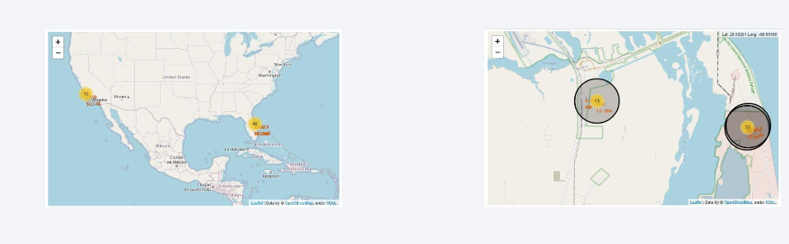
Results
Launch sites are typically located in safe coastal areas with robust surrounding infrastructure.
The majority of launches occur at East Coast sites.

Slide 18

Section 2

Slide 19
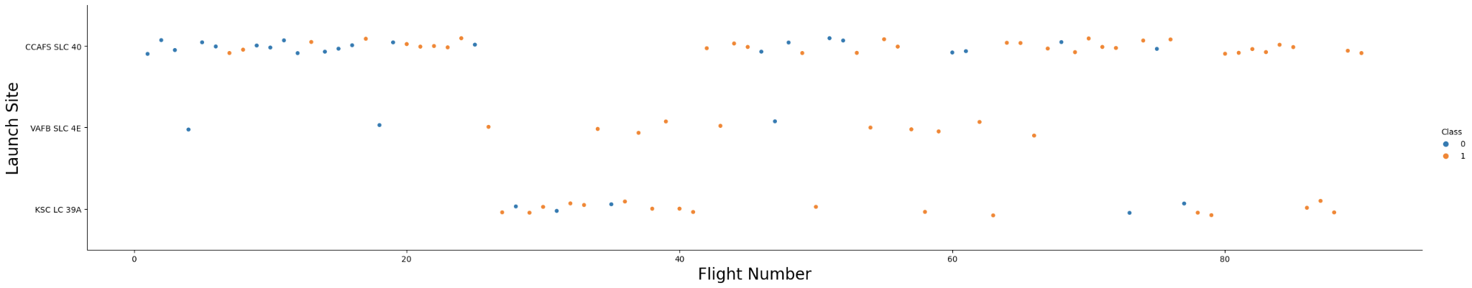
Flight Number vs. Launch Site
The plot revealed that launch sites with a higher number of flights tend to have greater launch success rates.

Slide 20
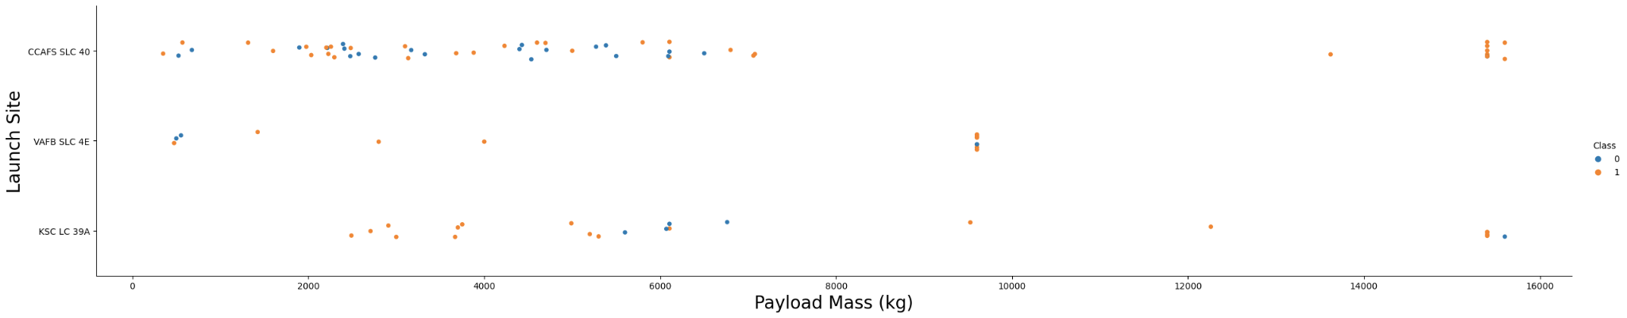
Payload vs. Launch Site
The Payload vs Launch Site plot shows no rockets with heavy payloads (greater than 10,000 kg) have been launched from the VAFB-SLC site.

Slide 21
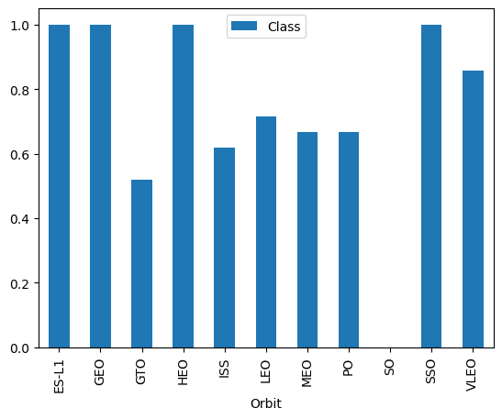
Success Rate vs. Orbit Type
The plot shows the orbits with the highest success rates are ES-L1, GEO, HEO, SSO, and VLEO.

Slide 22

Flight Number vs. Orbit Type
The Flight Number vs Orbit Type plot shows launches to LEO orbit have increasing success rates with more flights, whereas flights to GTO orbit display no clear trend between flight number and success.

Slide 23

Payload vs. Orbit Type
The plot shows successful landings with heavy payloads are more frequent for payloads to PO, LEO, and ISS orbits.

Slide 24
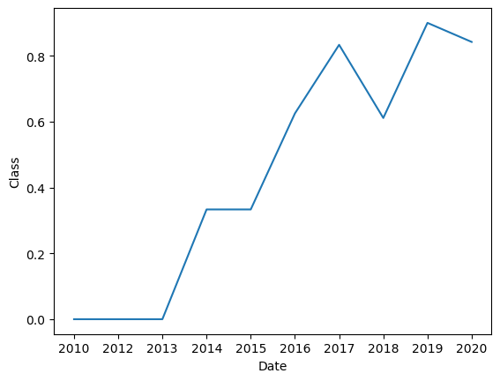
Launch Success Yearly Trend
The plot shows the success rate continually increased from 2013 to 2020.

Slide 25

All Launch Site Names
We used the keyword DISTINCT to show only unique launch sites from the SpaceX data.

Slide 26

Launch Site Names Begin with 'CCA'
The query displays the top 5 launch site records where the site name begins with "CCA".

Slide 27

Total Payload Mass
The query calculates the total payload mass carried by NASA boosters as 45,596 kg.

Slide 28

Average Payload Mass by F9 v1.1
The query determines the average payload mass for the F9 v1.1 booster version is 2,928.4 kg.

Slide 29

First Successful Ground Landing Date
The query shows the first successful ground pad landing occurred on December 22, 2015.

Slide 30

Successful Drone Ship Landing with Payload between 4000 and 6000
The query filters for boosters with successful drone ship landings having payloads between 4,000 kg and 6,000 kg using WHERE and AND clauses.

Slide 31

Total Number of Successful and Failure Mission Outcomes
The query uses a wildcard '%' with the WHERE clause to filter for all MissionOutcome values containing "success" or "failure".

Slide 32

Boosters Carried Maximum Payload
The query identifies the boosters carrying maximum payload using a subquery with the MAX() function in the WHERE clause.

Slide 33

2015 Launch Records
The query filters for failed drone ship landings in 2015 using WHERE, LIKE, AND, and BETWEEN clauses to specify booster versions and launch sites.

Slide 34

Rank Landing Outcomes Between 2010-06-04 and 2017-03-20
The query selects Landing outcomes and counts the outcomes WHERE the date is BETWEEN 2010-06-04 and 2017-03-20. It groups outcomes using GROUP BY and orders the groups in descending count with ORDER BY.

Slide 35

Section 3

Slide 36

All launch sites global map markers

Slide 37

Markers showing launch sites with color labels

Slide 38

Launch Site distance to landmarks

Slide 39

Section 4

Slide 40

Pie chart showing the success percentage achieved by each launch site

Slide 41

Pie chart showing the Launch site with the highest launch success ratio

Slide 42

Scatter plot of Payload vs Launch Outcome for all sites, with different payload selected in the range slider

Slide 43

Section 5

Slide 44
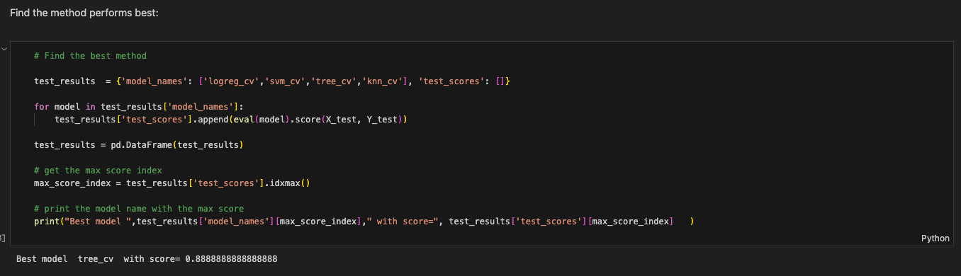
Classification Accuracy
The decision tree classifier is the model with the highest classification accuracy

Slide 45

Confusion Matrix
The Decision Tree confusion matrix demonstrates the classifier can differentiate between classes. However, a key issue is false positives, where unsuccessful landings are incorrectly classified as successful.

Slide 46
Conclusions
Launch sites with more flights have greater success rates
Success rate increased steadily from 2013 to 2020
Highest success rates achieved for orbits ES-L1, GEO, HEO, SSO, VLEO
Most successful launches occurred at site KSC LC-39A
Decision tree classifier is the optimal ML algorithm

Slide 47


